Slide 1

Forecasting Initial and Continued Unemployment Insurance Claims
Landa Gang
Anna Liu
Yuxi Xiao
Mingli Xu

Slide 2
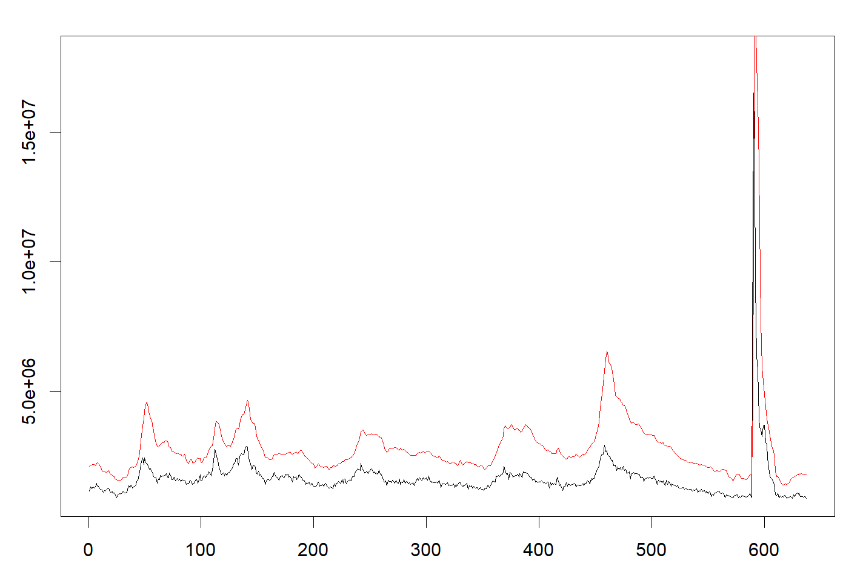
Key Variables and Data Overview
Dependent Variables
Independent Variables
Initial Claims (IC) and Continued Claims (CC) from Unemployment Insurance Weekly Claims Data, seasonally adjusted.
Unemployment Level, Job Losers, Discouraged Workers, CPI, Core CPI, PCE, Consumer Sentiment, Hourly Earnings, Real GDP, Interest Rate, NASDAQ Index.
Data Span
Monthly U.S. data from February 1971 to February 2024, totaling 637 months.

Slide 3
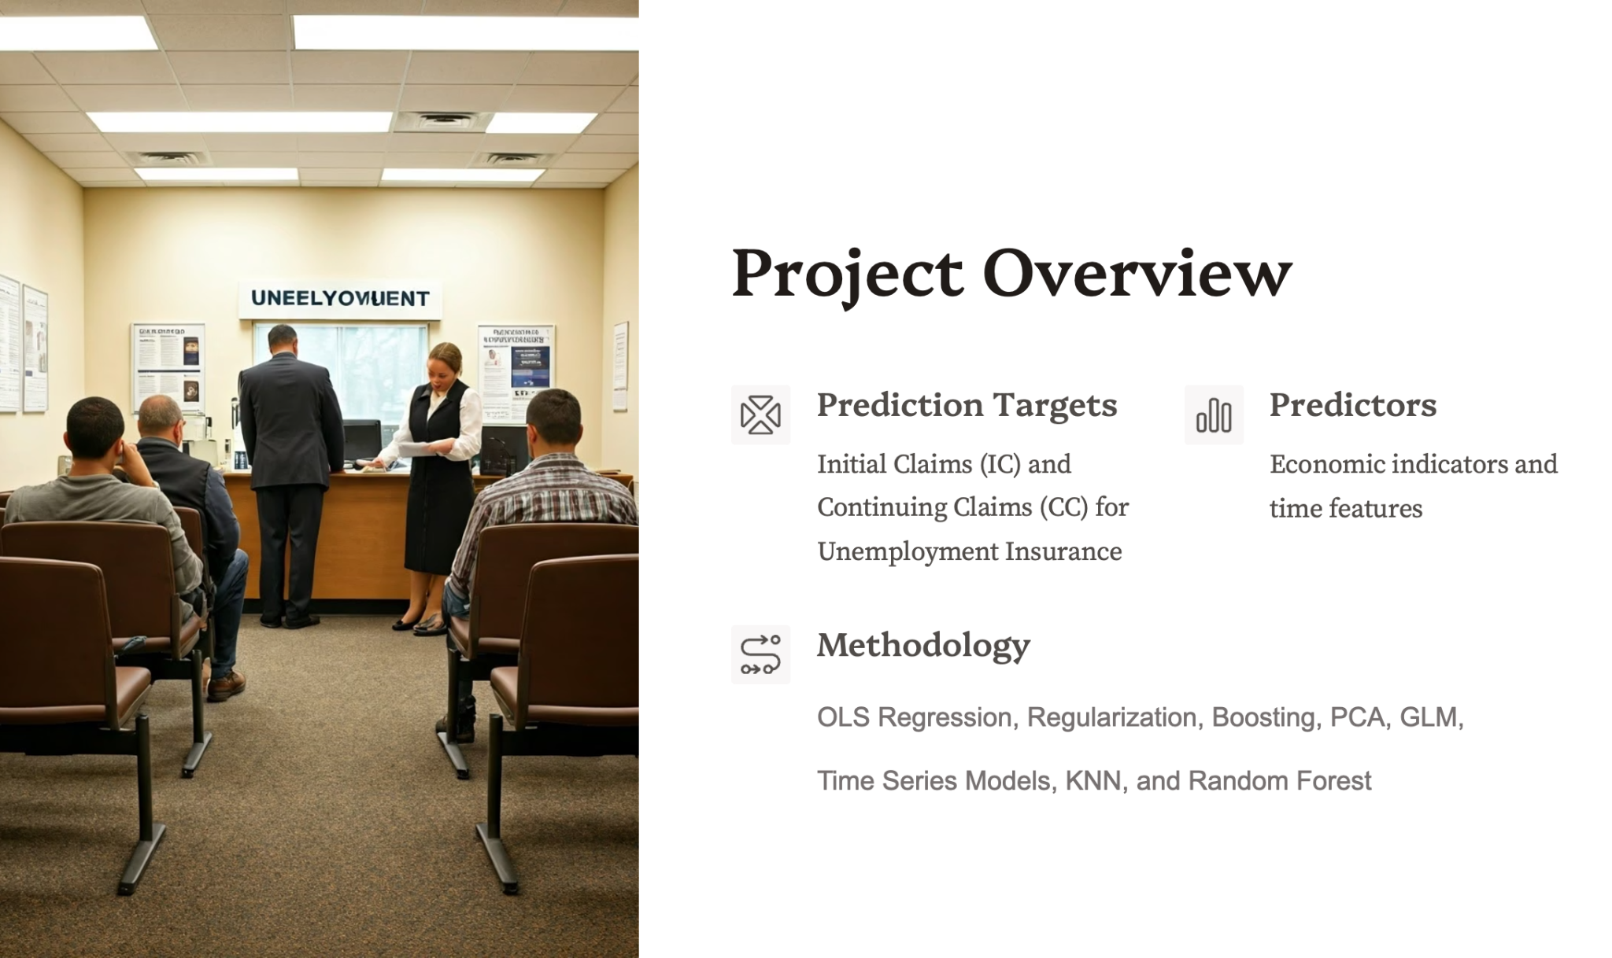

Slide 4



IC
 | coef | P-value
Intercept | -0.14921302 | 3.22E-02
Unemployment Level | 1.40300736 | 3.80E-68
Discouraged Workers | -0.95516392 | 1.06E-31
△rCPI | 0.02741772 | 4.65E-01
Adjusted Hourly Earnings | 0.43012102 | 3.22E-16
Consumer Sentiment | 0.27910859 | 3.12E-10
Adjusted real GDP | -0.29745441 | 2.09E-09
Interest Rate | 0.41402274 | 1.11E-04
△rNASDAQ Index | -0.06197413 | 1.55E-01
△Unemployment Level | 0.13135357 | 1.74E-03
△Discouraged Workers | 0.13959008 | 1.06E-04
△Interest Rate | -0.45704389 | 6.50E-05
Multinomial Regression Findings with Discouraged Workers
Negative Impact of Discouraged Workers
Significant negative effect on both IC and CC, stronger for CC, confirming fewer claims with more discouraged workers.
Positive Correlation of Changes
Changes in Discouraged Workers positively correlate with IC and CC, reflecting shared employment environment influences.
Model Strength
High Adjusted R-squared values (0.7648 for IC, 0.8754 for CC) indicate strong explanatory power.

Slide 5
CC
 | coef | P-value
(Intercept) | -0.1648521 | 1.06E-03
Unemployment Level | 1.89264268 | 3.45E-135
Discouraged Workers | -1.30339675 | 1.22E-77
△rCPI | -0.01527346 | 5.72E-01
Adjusted Hourly Earnings | 0.40625148 | 2.98E-25
Consumer Sentiment | 0.2130917 | 2.85E-11
Adjusted real GDP | 0.08092712 | 2.05E-02
Interest Rate | 0.33852698 | 1.19E-05
△rNASDAQ Index | -0.03062759 | 3.29E-01
△Unemployment Level | -0.10103809 | 8.26E-04
△Discouraged Workers | 0.17687152 | 2.45E-11
△Interest Rate | -0.19773331 | 1.55E-02
Multinomial Regression Findings with Discouraged Workers
Negative Impact of Discouraged Workers
Significant negative effect on both IC and CC, stronger for CC, confirming fewer claims with more discouraged workers.
Positive Correlation of Changes
Changes in Discouraged Workers positively correlate with IC and CC, reflecting shared employment environment influences.
Model Strength
High Adjusted R-squared values (0.7648 for IC, 0.8754 for CC) indicate strong explanatory power.

Slide 6
Comparing Models: Unemployment Level vs. Job Losers and Inflation Effects
Job Losers vs. Unemployment Level
Inflation Impact
Models using Job Losers show stronger explanatory power, especially for CC, highlighting passive unemployment's role.
Inflation variables insignificant for IC but PCE significant for CC, indicating inflation influences continued claims more.
adjusted R^2 | IC | CC
Unemployment Level | 0.5762 | 0.5625
Job Losers | 0.6745 | 0.7203
△rCPI | 0.6745 | 0.7203
△rCore CPI | 0.6744 | 0.7205
△rPCE | 0.6735 | 0.7255
△rPCEPI | 0.6745 | 0.7202

Slide 7
IC
 | coef | P-value
(Intercept) | 0.00000 | 1.00000
Job Losers | 0.70851 | 0.00000
Adjusted Hourly Earnings | 0.17829 | 0.00000
Consumer Sentiment | 0.17209 | 0.00000
Adjusted real GDP | -0.19472 | 0.00000
Interest Rate | 0.29101 | 0.00000
△Interest Rate | -0.06806 | 0.00372
△Job Losers | 0.29102 | 0.00000
CC
 | coef | P-value
(Intercept) | 0.00000 | 1.00000
Job Losers | 0.91459 | 0.00000
△rPCE | 0.12645 | 0.00001
Adjusted Hourly Earnings | 0.15002 | 0.00000
Consumer Sentiment | 0.10863 | 0.00002
Interest Rate | 0.17864 | 0.00000
△Job Losers | 0.05966 | 0.03866
△Interest Rate | -0.04467 | 0.03634
Regression Models and Key Variable Impacts
IC Simplified Model
CC Simplified Model
Interpretation
Includes Job Losers, Adjusted Hourly Earnings, Consumer Sentiment, Adjusted real GDP, Interest Rate, and △Interest Rate.
Similar variables with additional △rPCE and △Job Losers; all significant at 0.05 level.
Job Losers and its change positively impact claims; GDP negatively affects IC but not CC

Slide 8
Regularization and Model Improvement
IC = 0.50431*Job Losers + -0.10936*Adjusted real GDP + 0.05814*Interest Rate + 0.29863*△Job Losers
CV error = 0.5274346
VS OLS: 0.5596423
CC = 0.65771 * Job Losers
CV error = 0.3288756
VS OLS: 0.7507784
IC Model
CC Model
Optimal alpha 0.9 with 90% LASSO; prediction error reduced significantly; only Job Losers, real GDP, Interest Rate, and △Job Losers retained.
Similar alpha; only Job Losers retained, suggesting it as the fundamental variable influencing CC.
Prediction Errors
Regularization improves errors compared to OLS, enhancing model reliability.

Slide 9
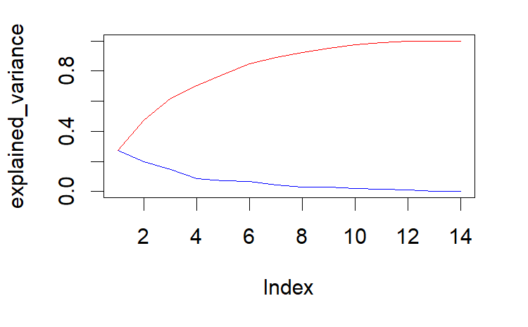
PCA
PCA Results
First four principal components explain ~78% variance; regression yields lower R-squared and higher prediction errors than OLS with various numbers of PC. PCA may not be suitable.

Slide 10
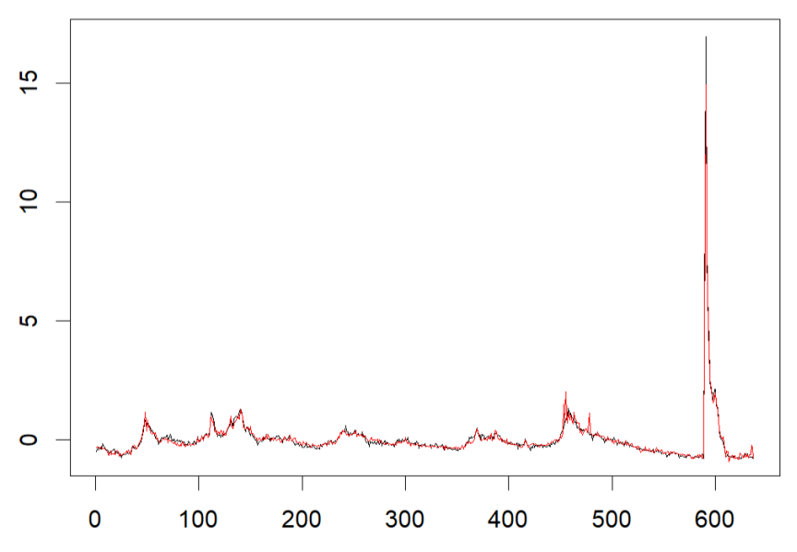
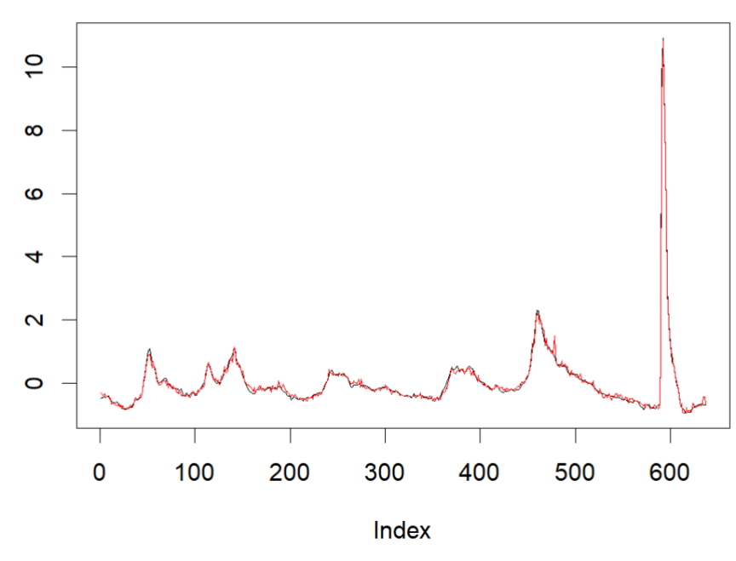
Boosting
IC
variable | importance
△rCPILFESL | 16.2731002
Adjusted Hourly Earnings | 14.146991
△Job Losers | 12.8905347
Job Losers | 12.2831192
Adjusted real GDP | 11.9168041
△Unemployment Level | 7.8793987
△rPCE | 5.9589564
Boosting Results
Boosting improves prediction errors over OLS (0.4626691 & 0.125189); for CC, it is even better than regularized regression.
Variable importance differs.
IC
CC
variable | importance
Job Losers | 47.423717
Adjusted Hourly Earnings | 17.098836
CC

Slide 11
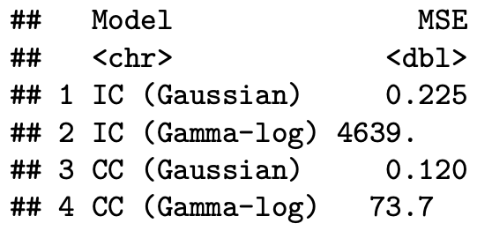
Applying Generalized Linear Models
Model Types Compared
Findings
Gaussian-identity link
Gamma-log link
Lower AIC confirms the Gamma–log link is a better fit than Gaussian‐identity.
Gamma-log link stabilizes variance and provides more stable and accurate predictions for both Initial Claims and Continued Claims.
Gaussian-identity produces lower in-sample MSEs for both Initial Claims and Continued claims.

Slide 12
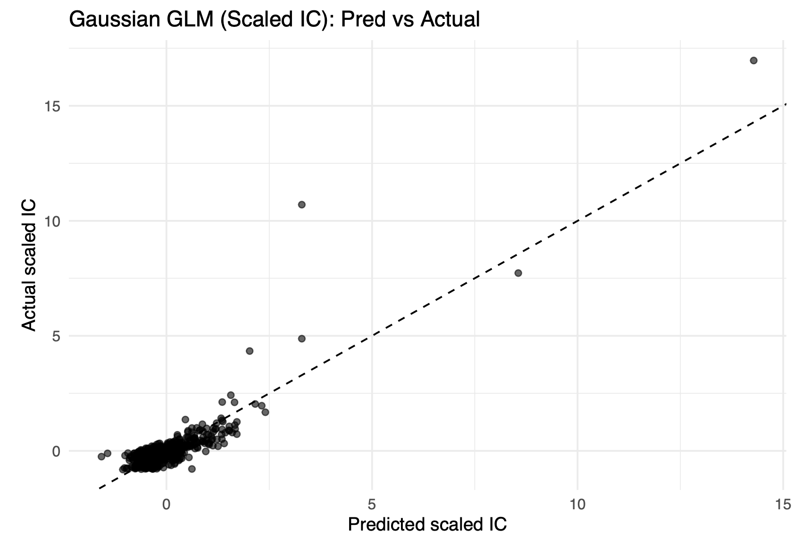
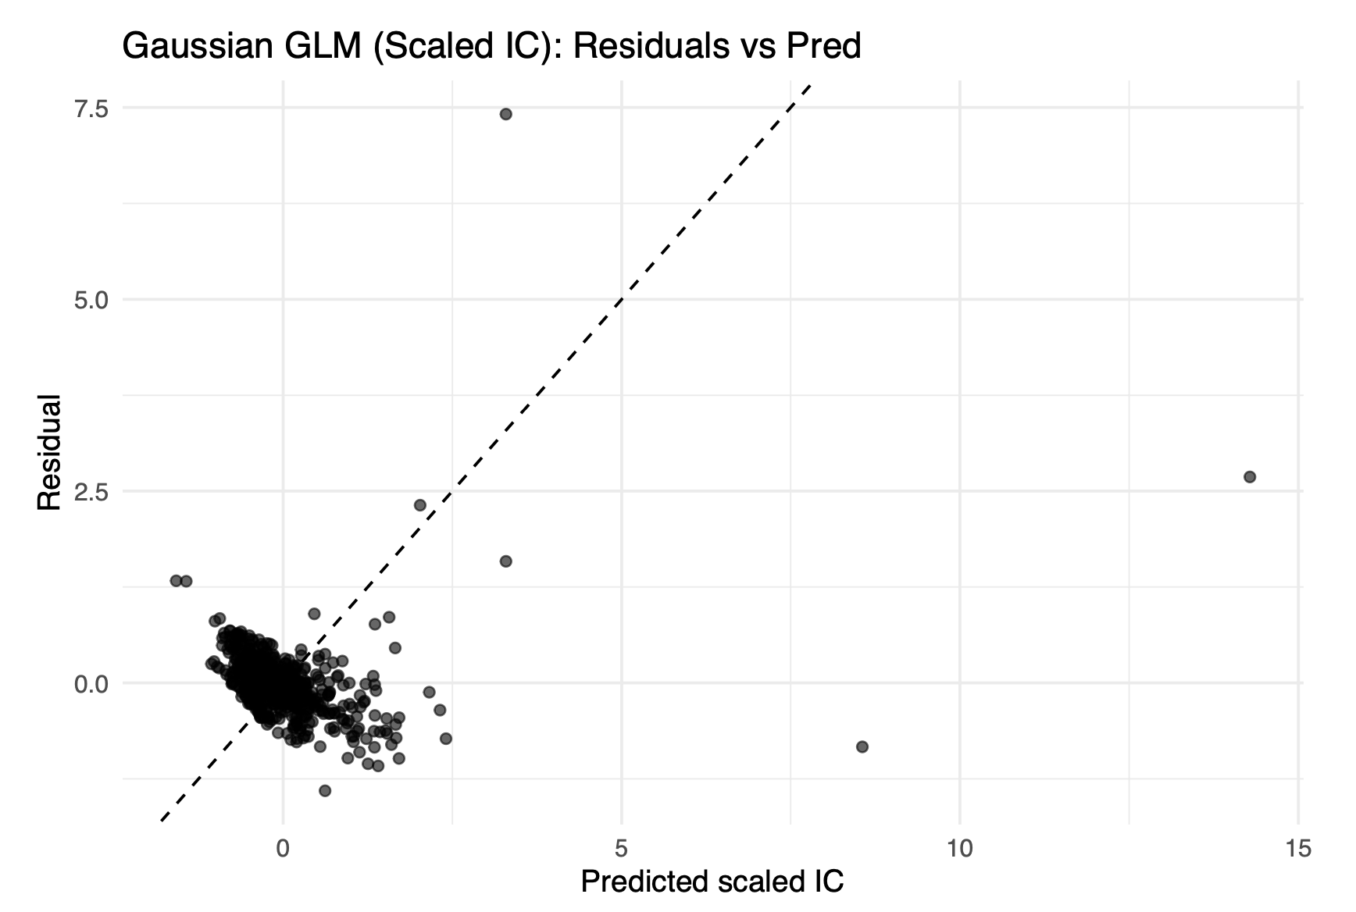
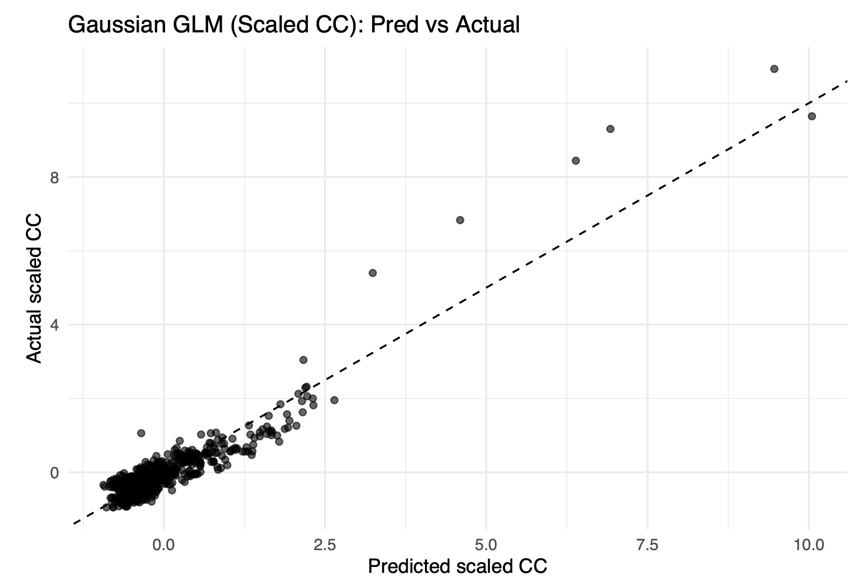
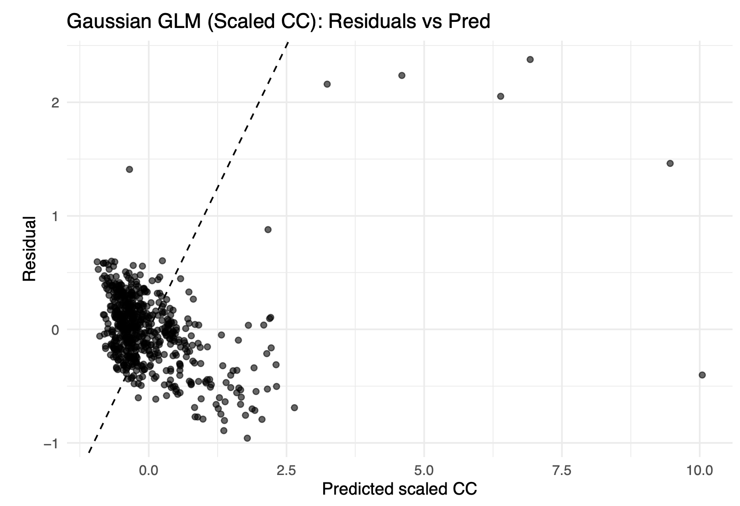
Gaussian-identity link for IC and CC

Slide 13
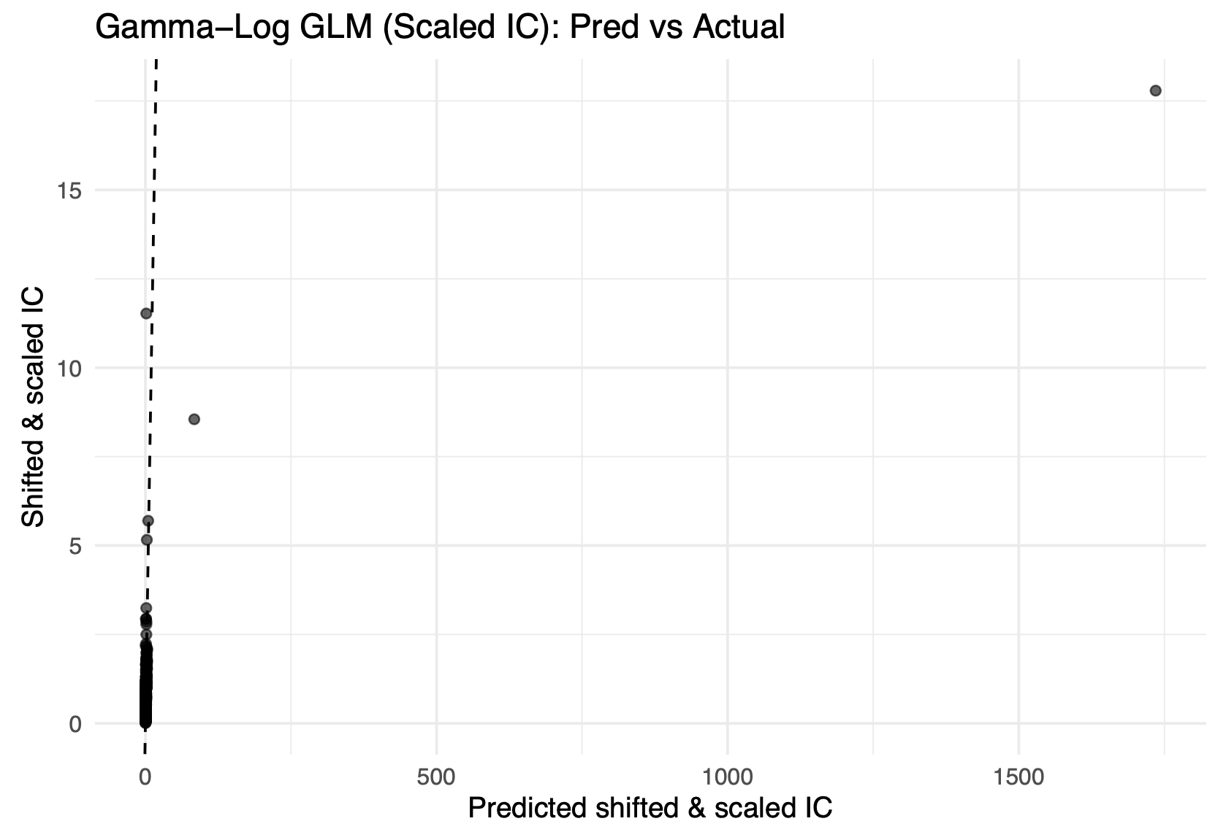
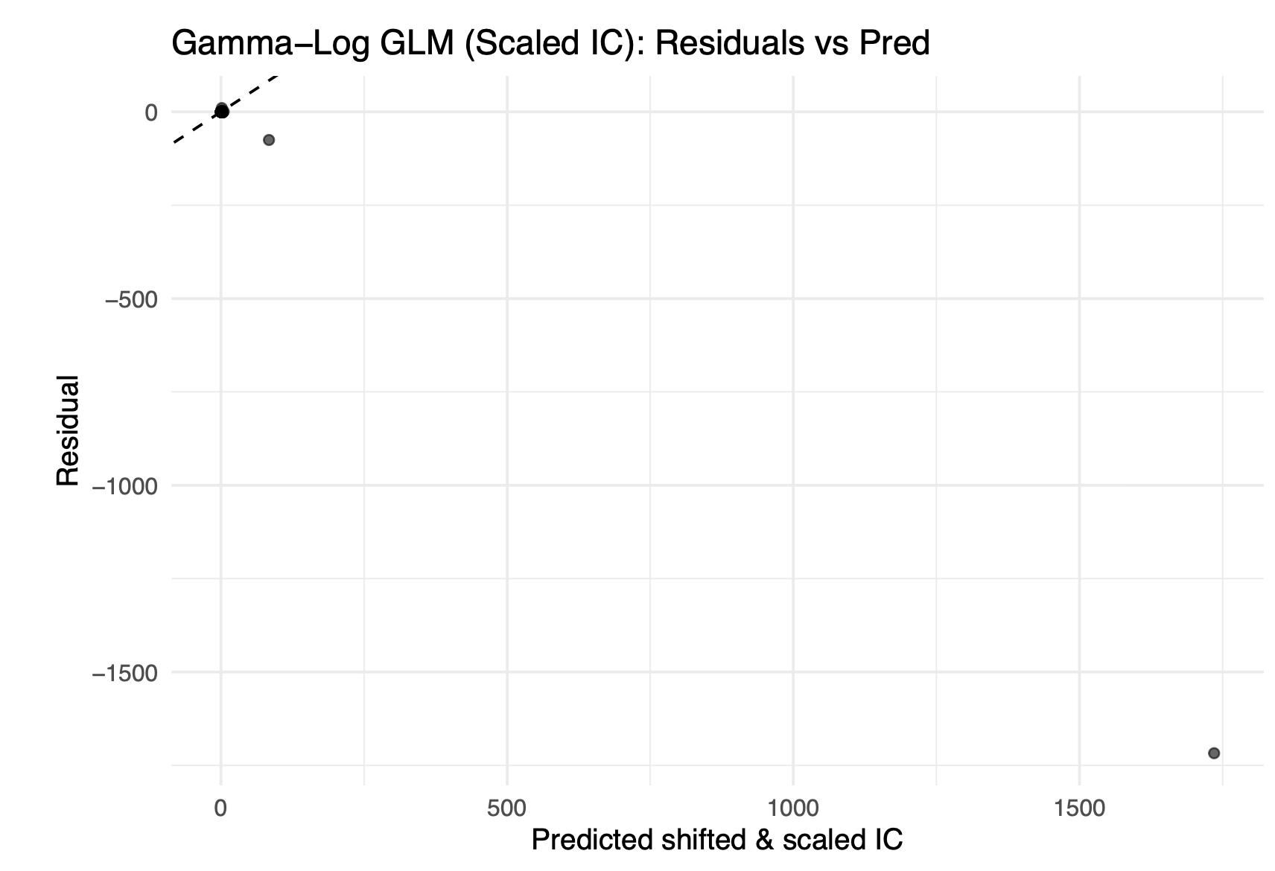
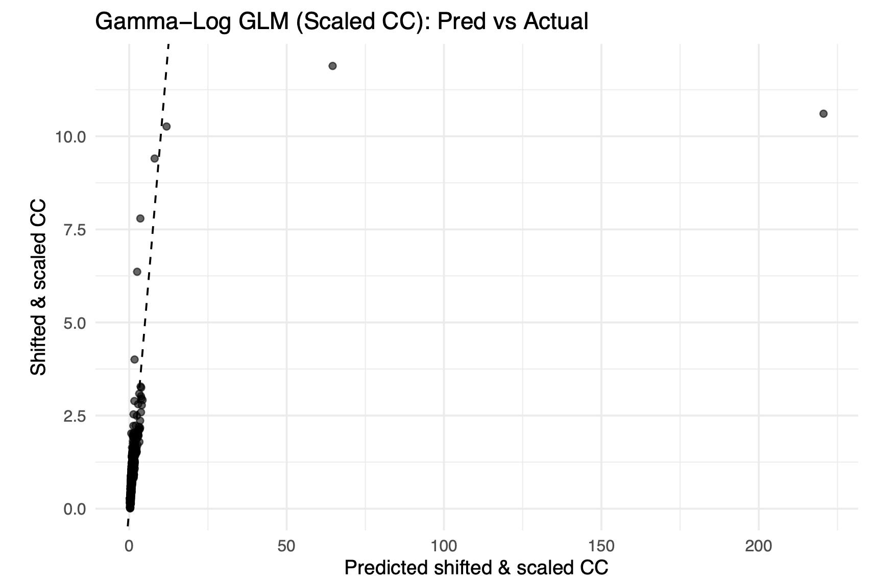
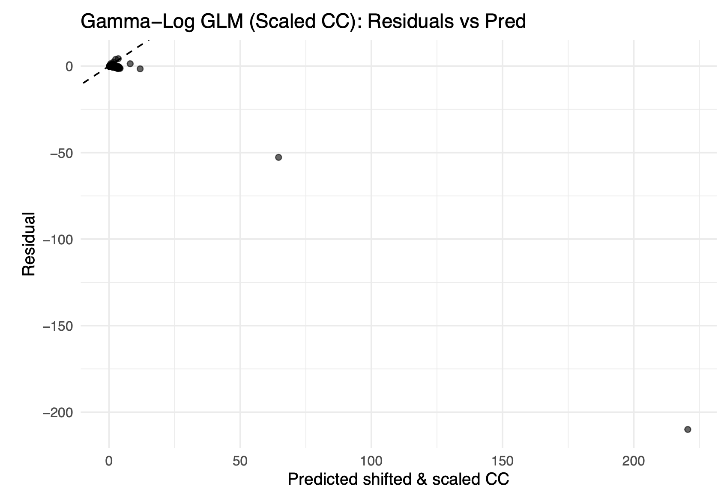
Gamma-log link for IC and CC

Slide 14
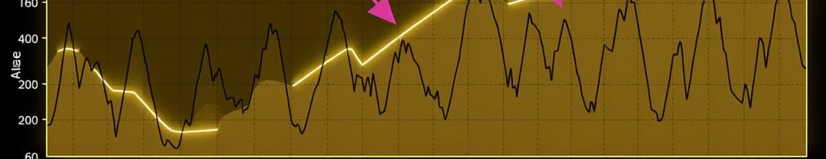
Time-Series Modeling for Dependency

Slide 15
Data preprocessing
Removed irrelevant columns
Handled missing values (using na.omit())
Created monthly time series objects:
IC_ts and CC_ts
Start: January 1970
Frequency: 12 (monthly)

Slide 16
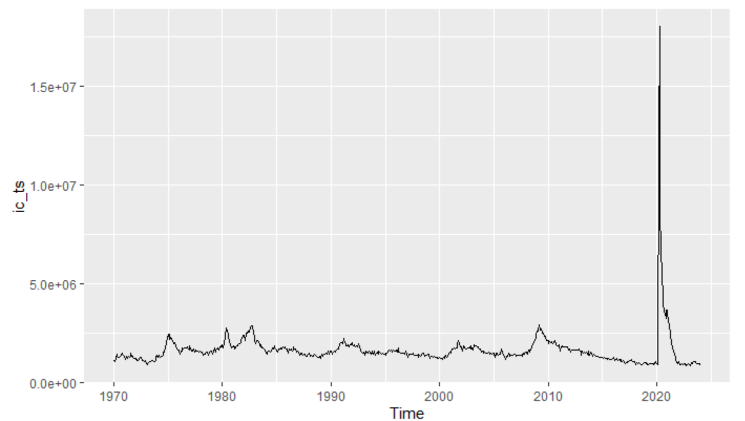
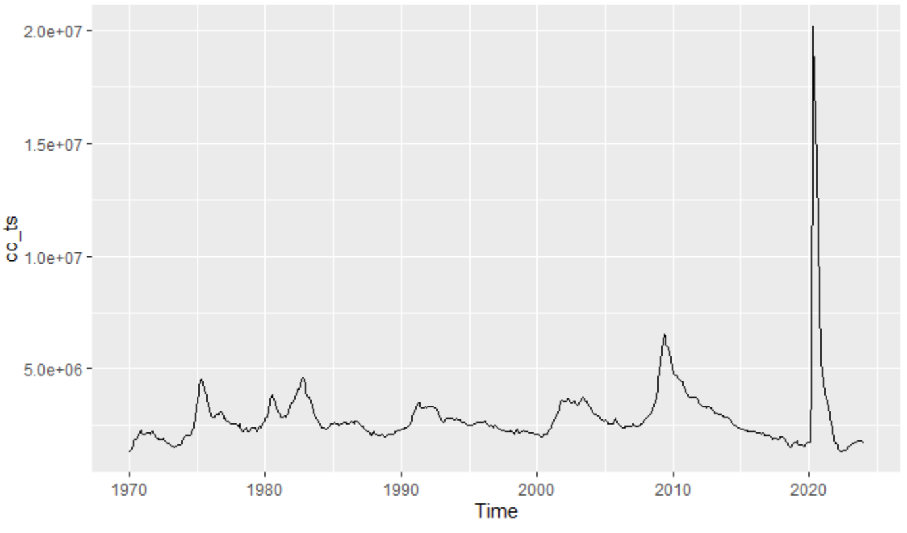
Initial Data Visualization
Initial Claims time series & Continued Claims time series

Slide 17
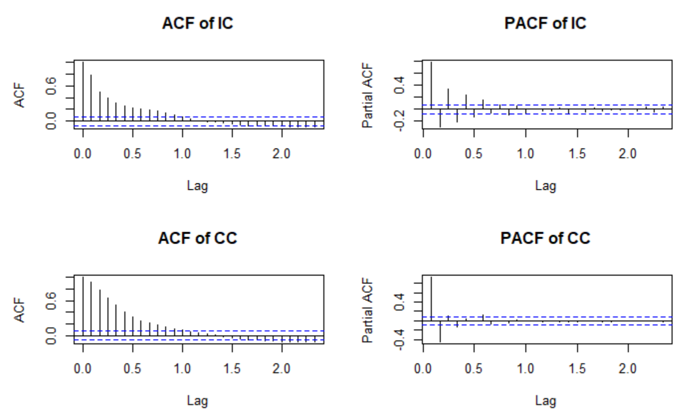
Modelling
Auto ARIMA:
Automatically selects optimal (p,d,q) parameters by minimizing AIC
Manual ARIMA:
Selected (p,d,q) based on ACF and PACF plots
Manually set model to (1,1,1)

Slide 18
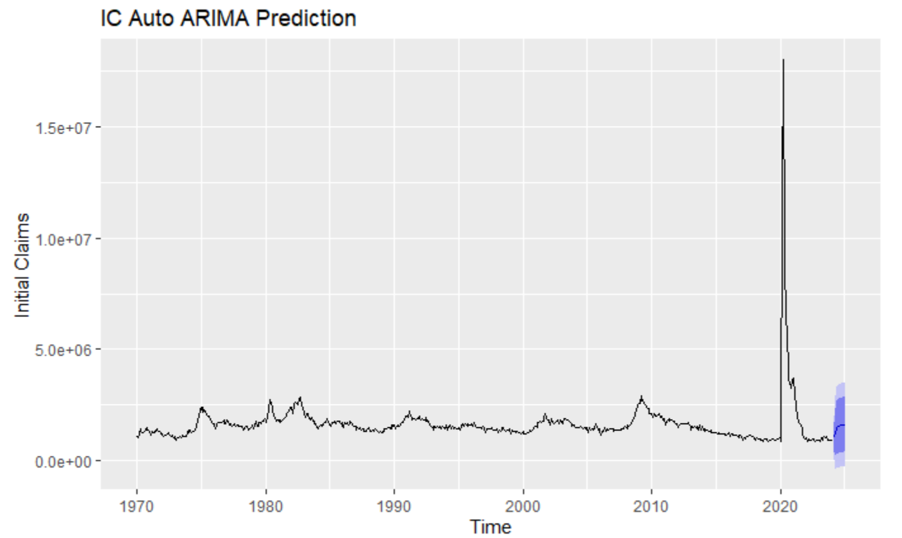
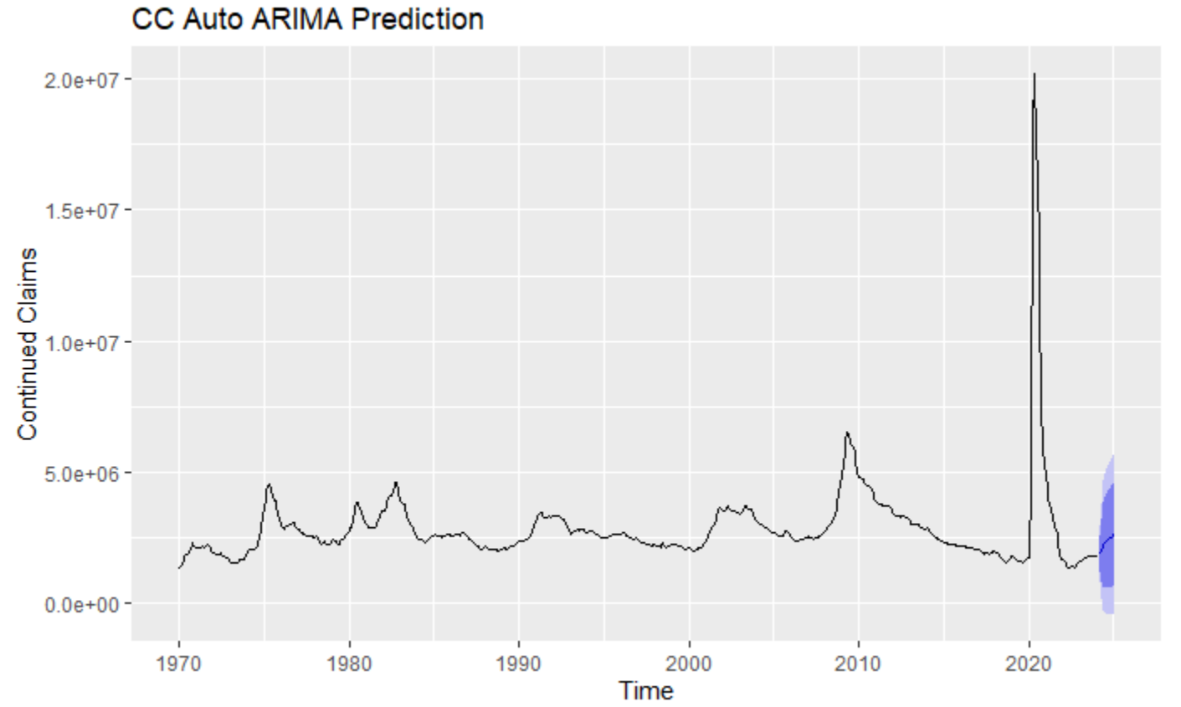
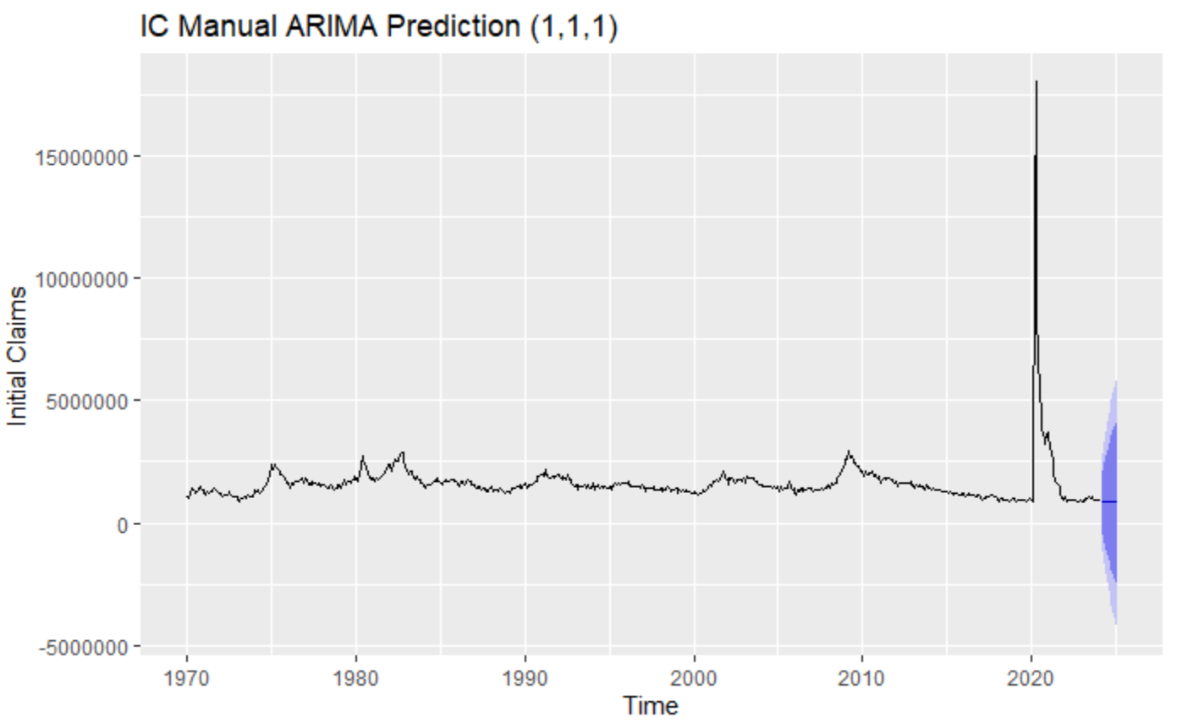
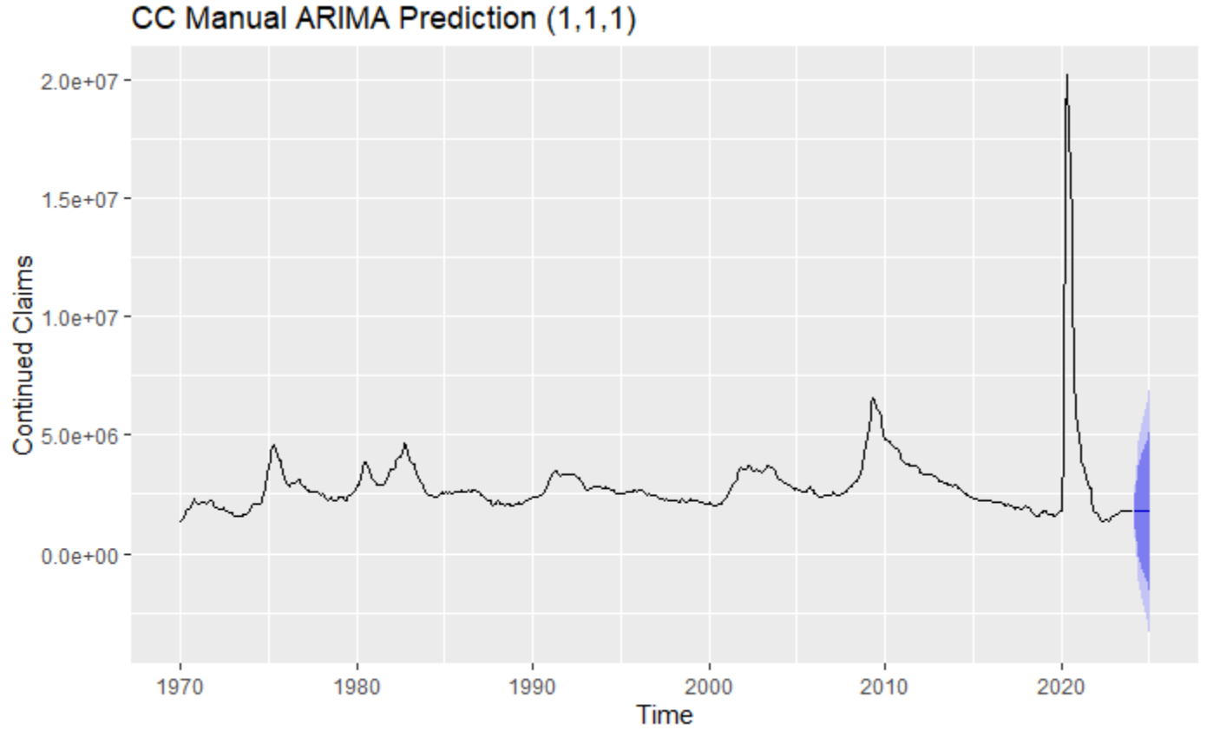
Model Comparison
Auto ARIMA (3,2,3):
AIC = 18906
BIC = 18937
Manual ARIMA (1,1,1):
AIC = 19004
BIC = 19017
Auto ARIMA (1,0,1):
AIC = 18987
BIC = 19005
Manual ARIMA (1,1,1):
AIC = 18997
BIC = 19010

Slide 19
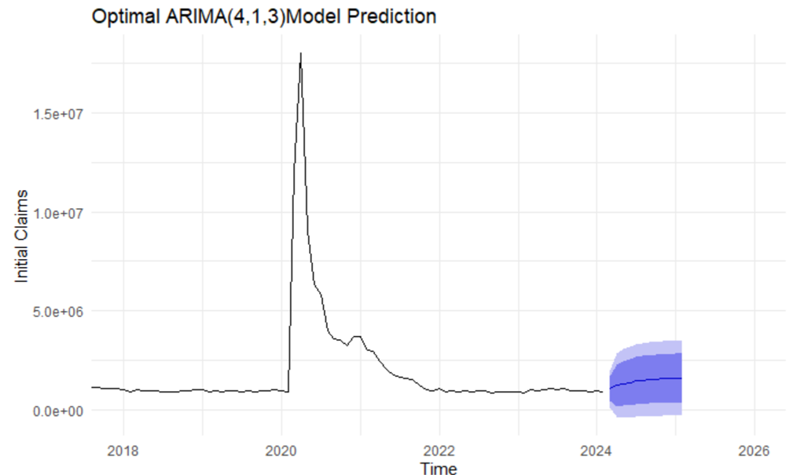
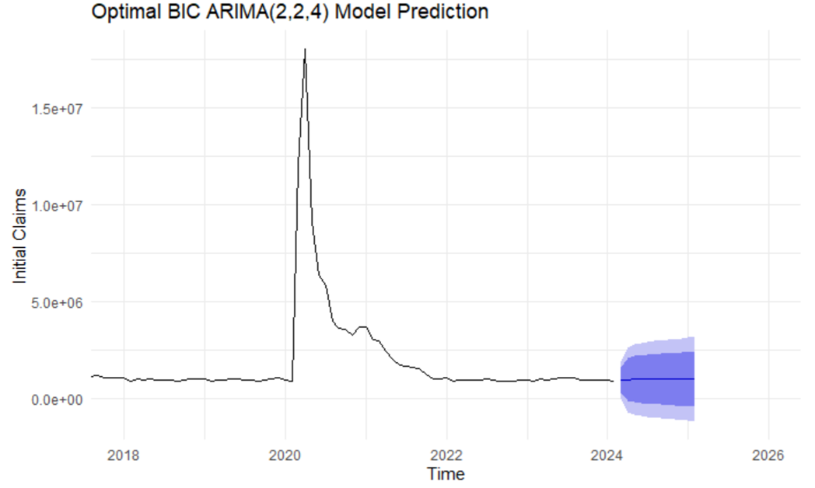
Optimal model selection
Best model of IC:
ARIMA(4,1,3)-based on AIC,
ARIMA(2,2,4)-based on BIC

Slide 20
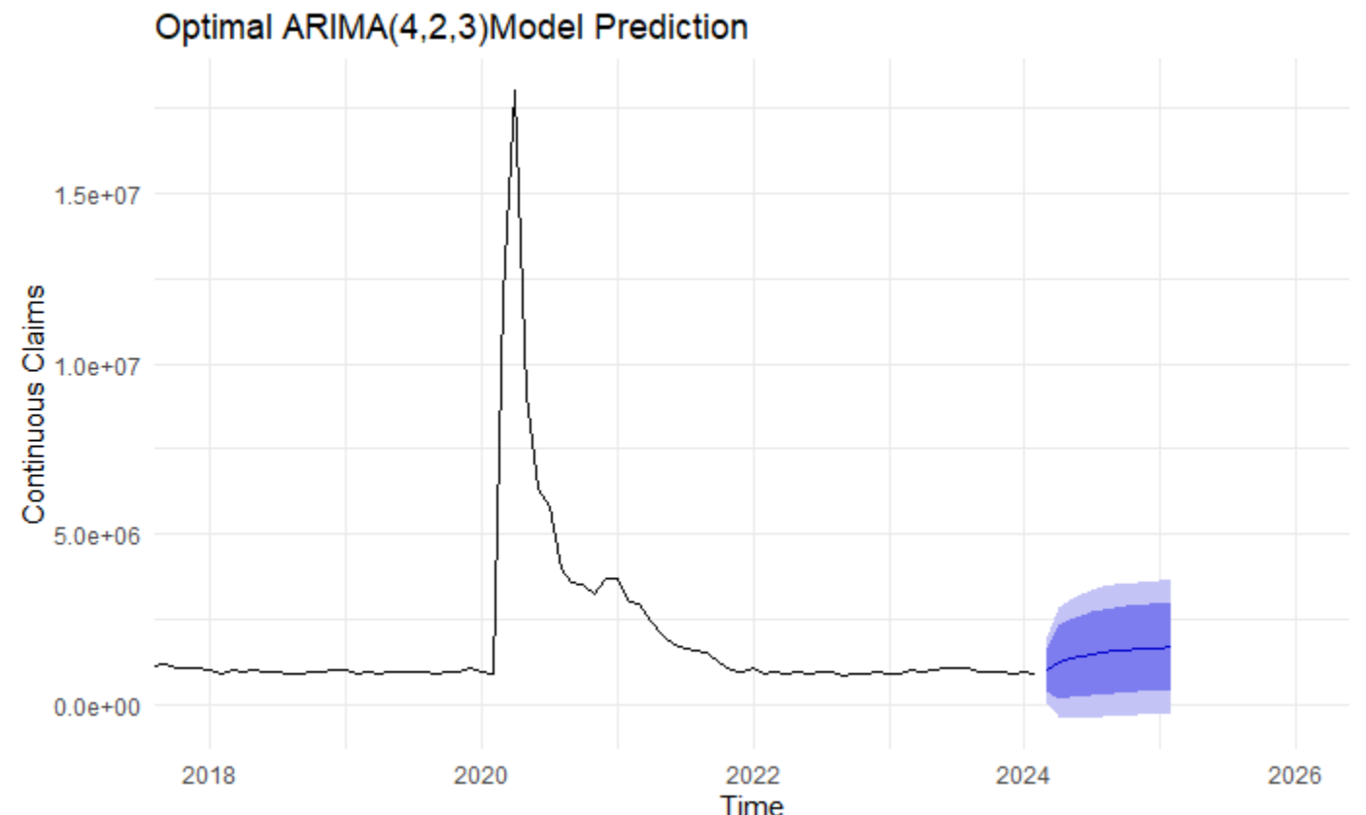
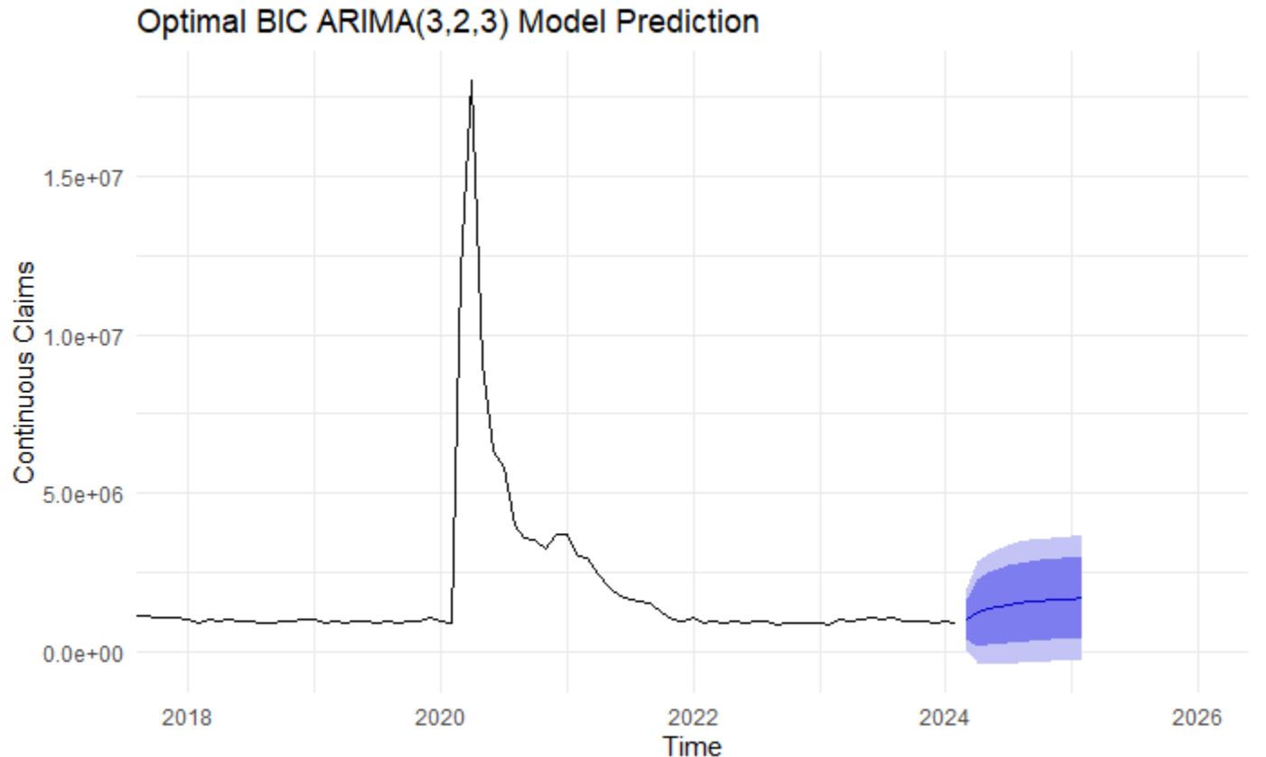
Optimal model selection
Best model of IC:
ARIMA(4,2,3)-based on AIC,
ARIMA(3,2,3)-based on BIC

Slide 21
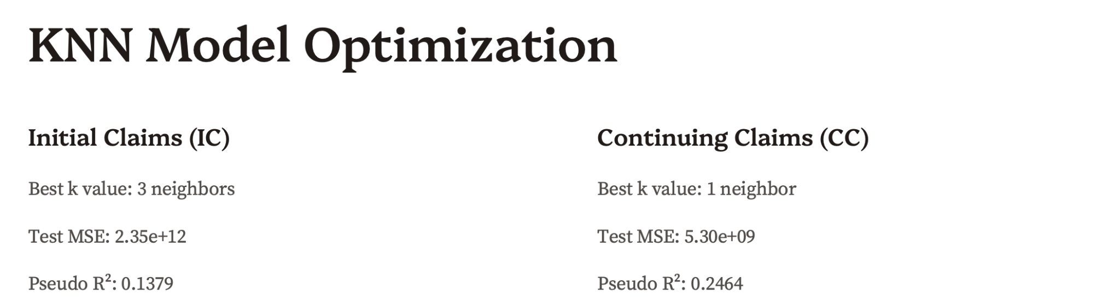

Slide 22
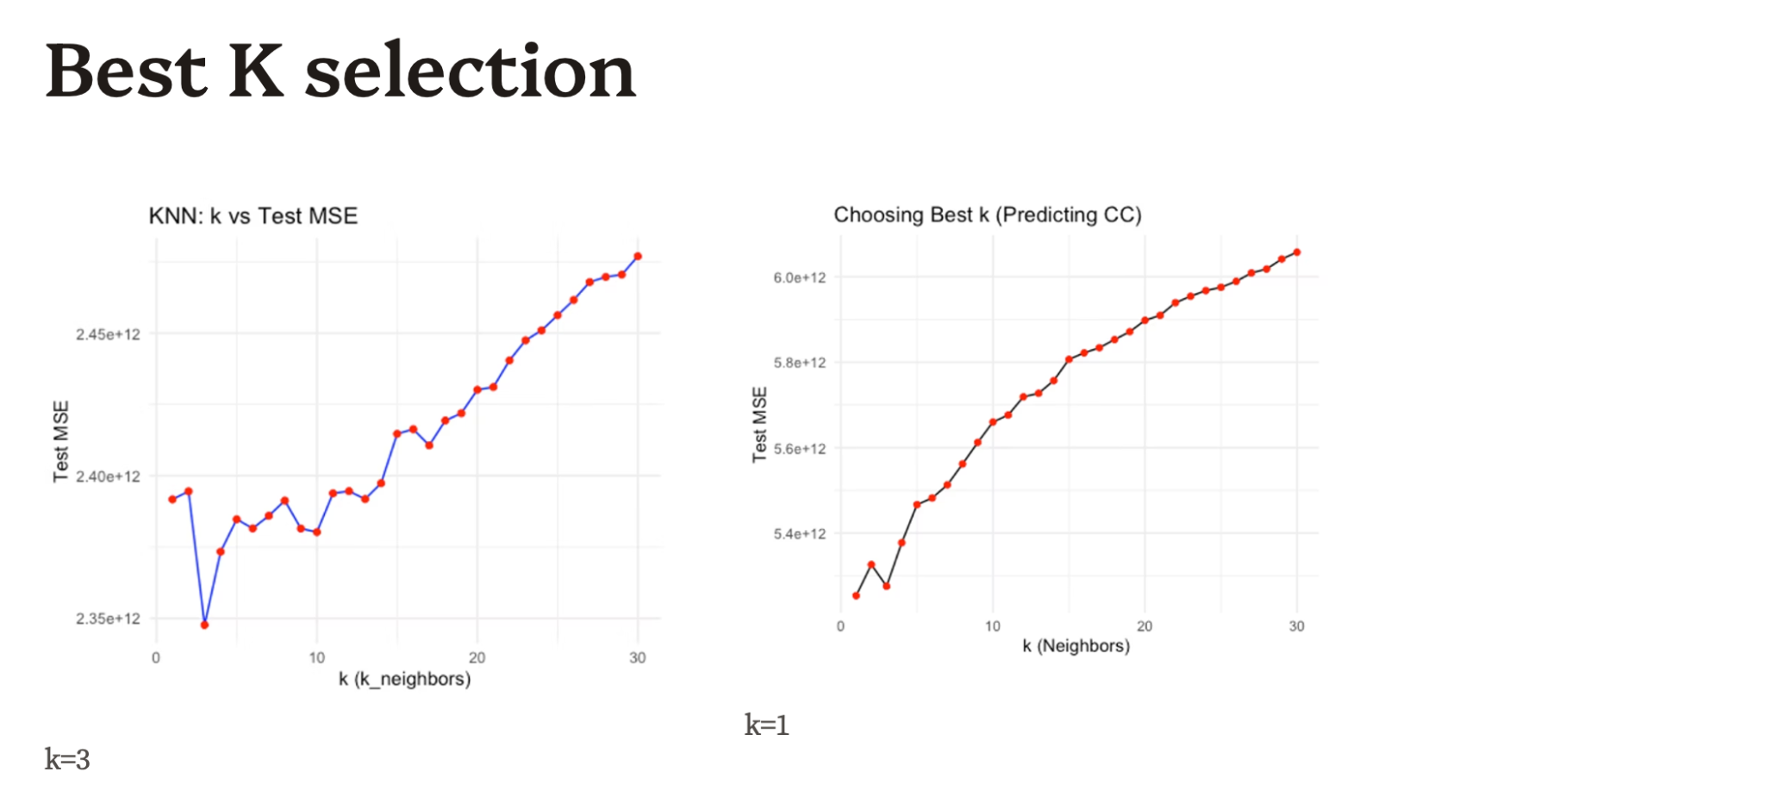

Slide 23
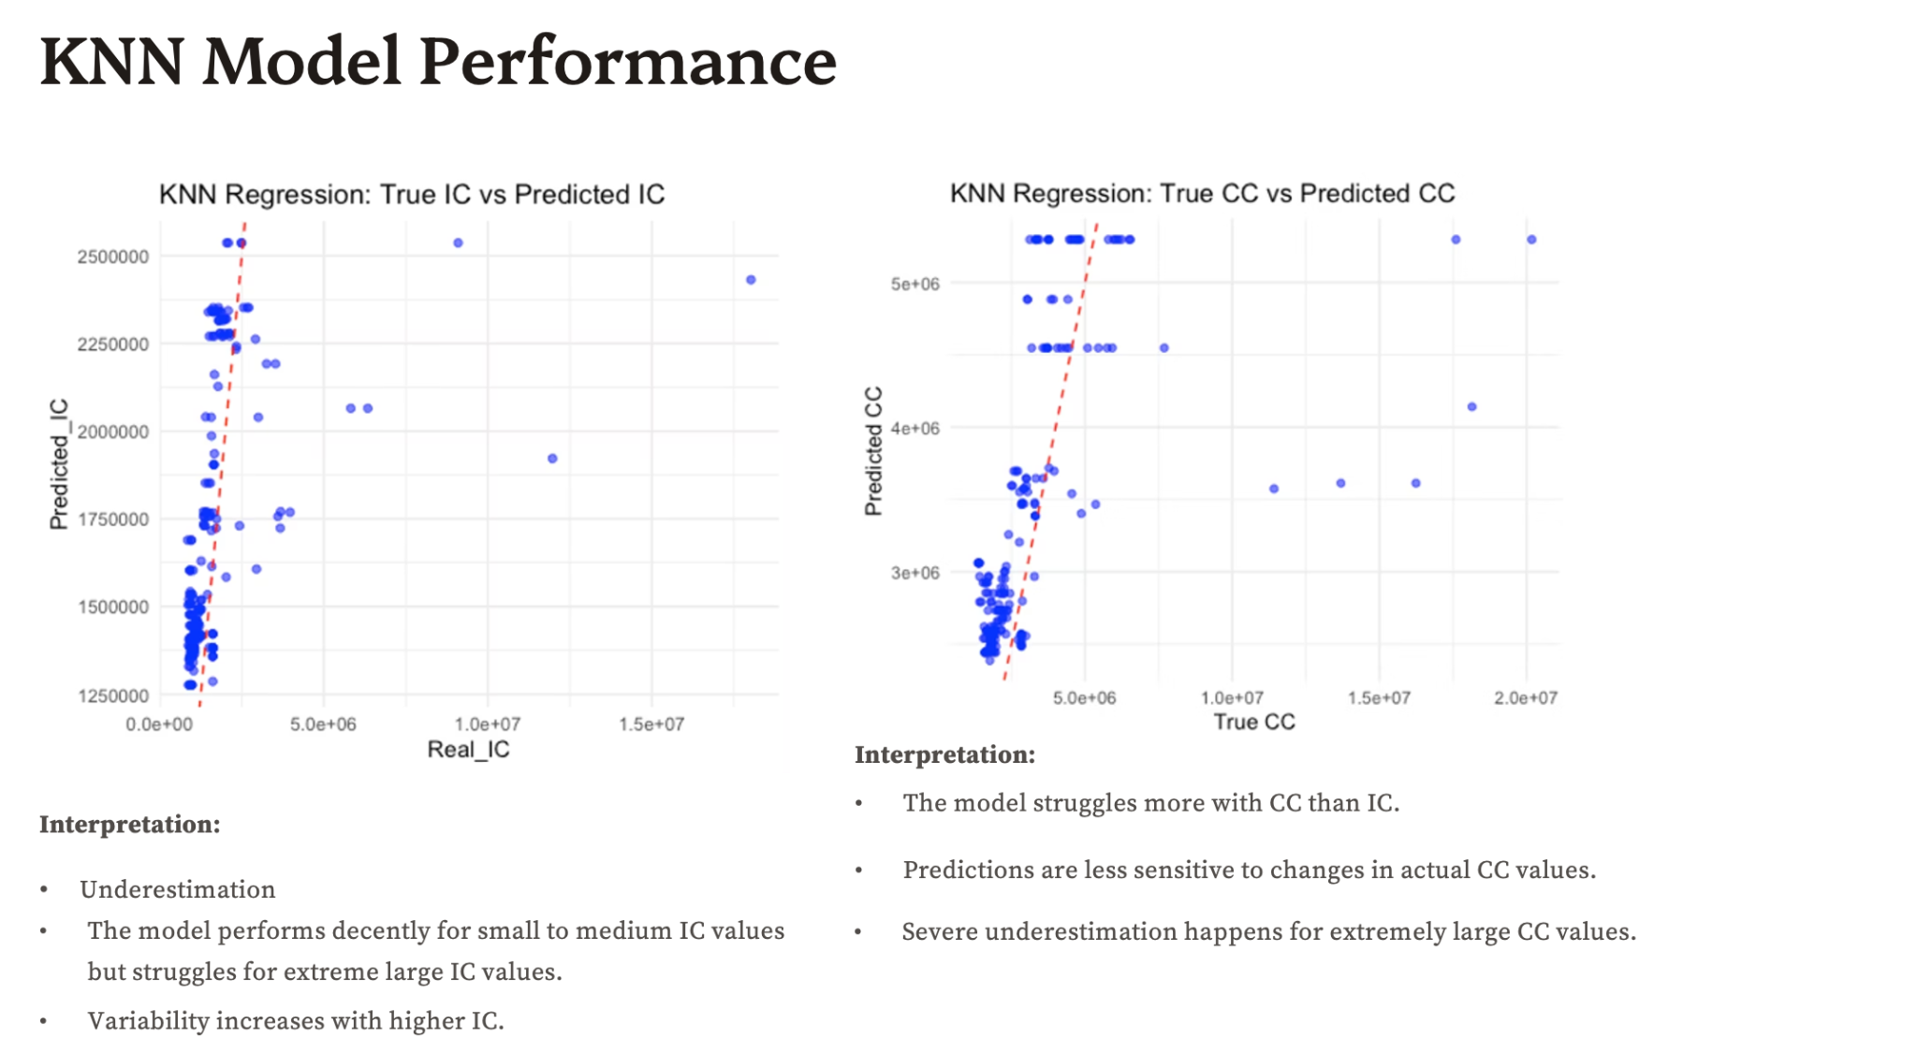

Slide 24
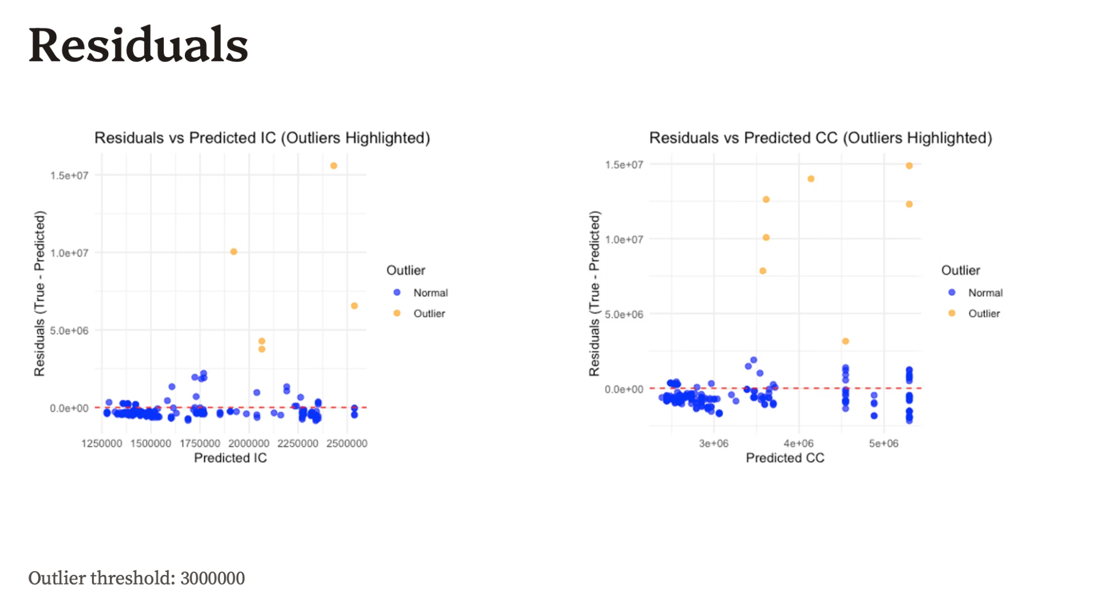

Slide 25
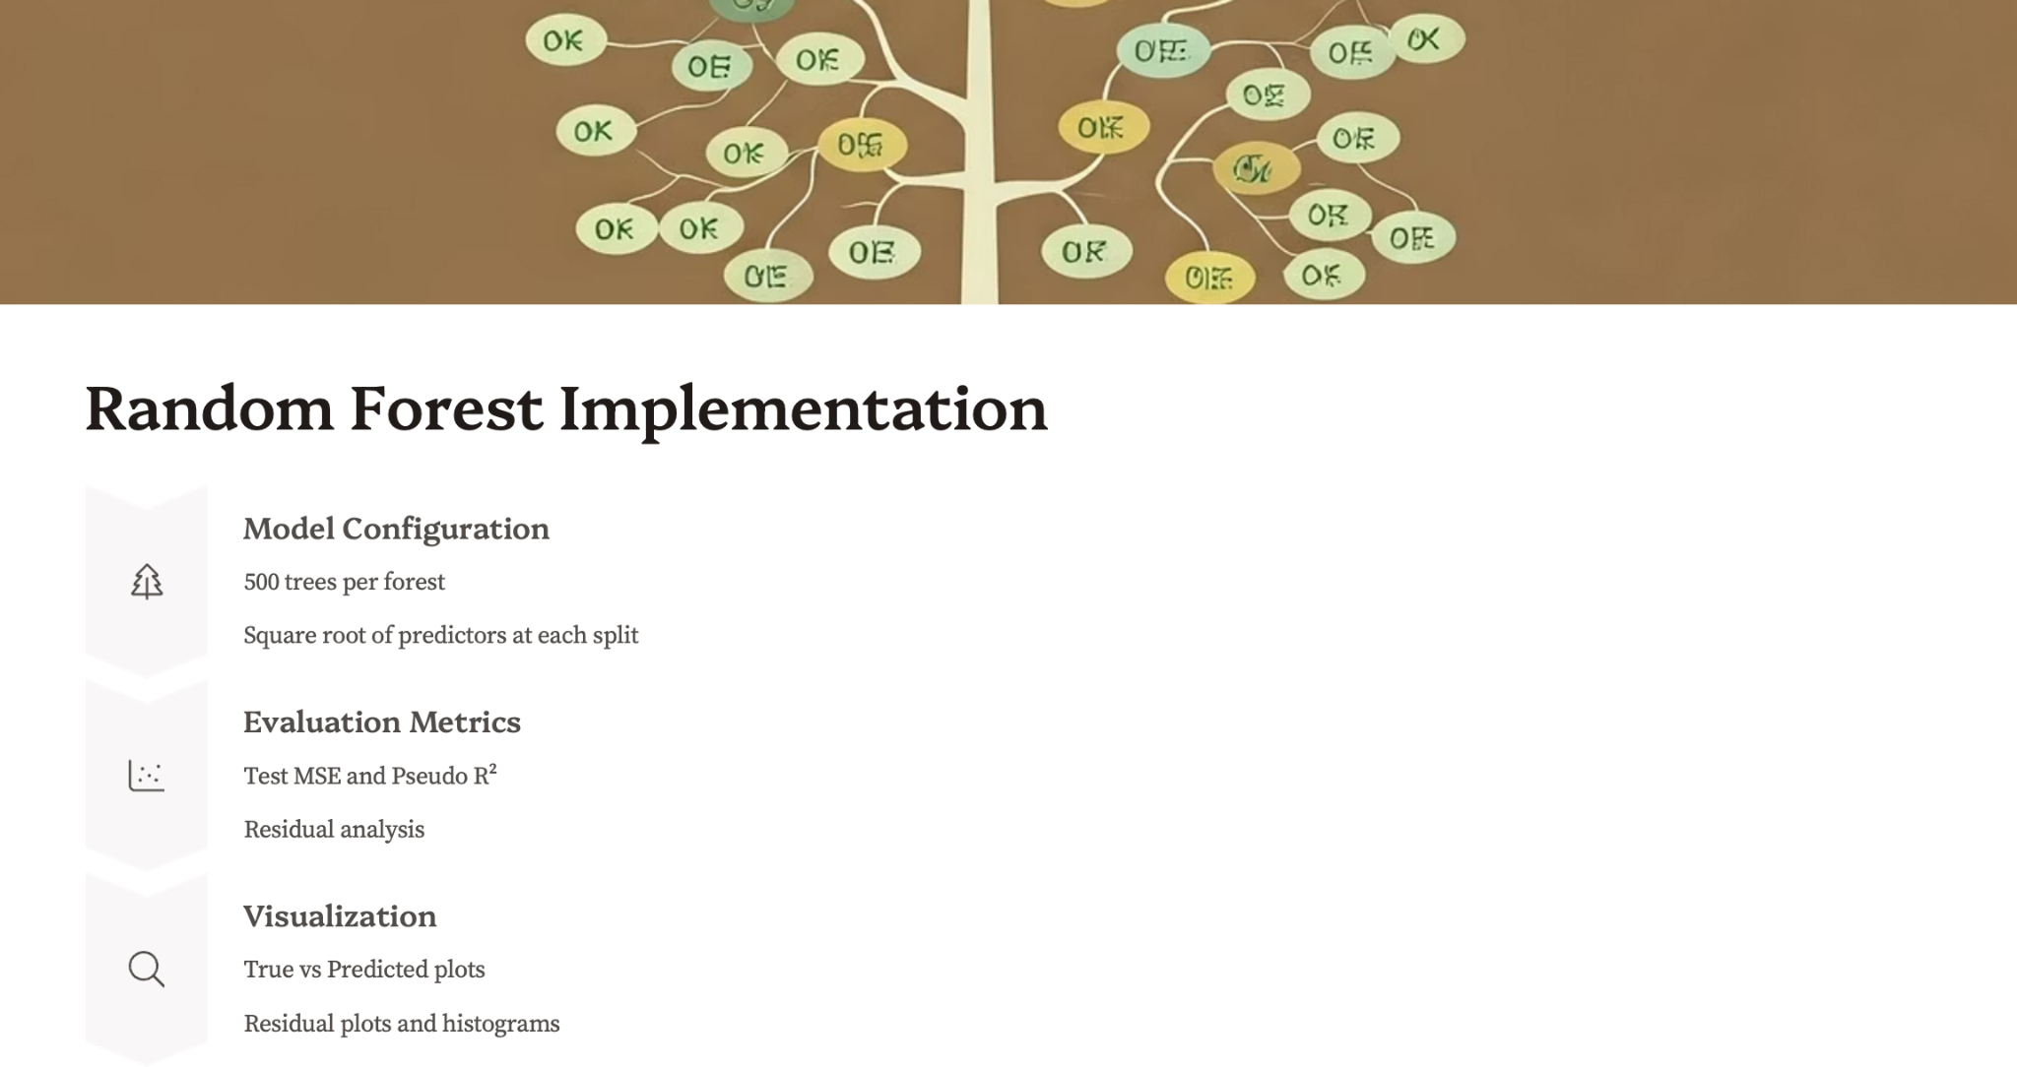

Slide 26
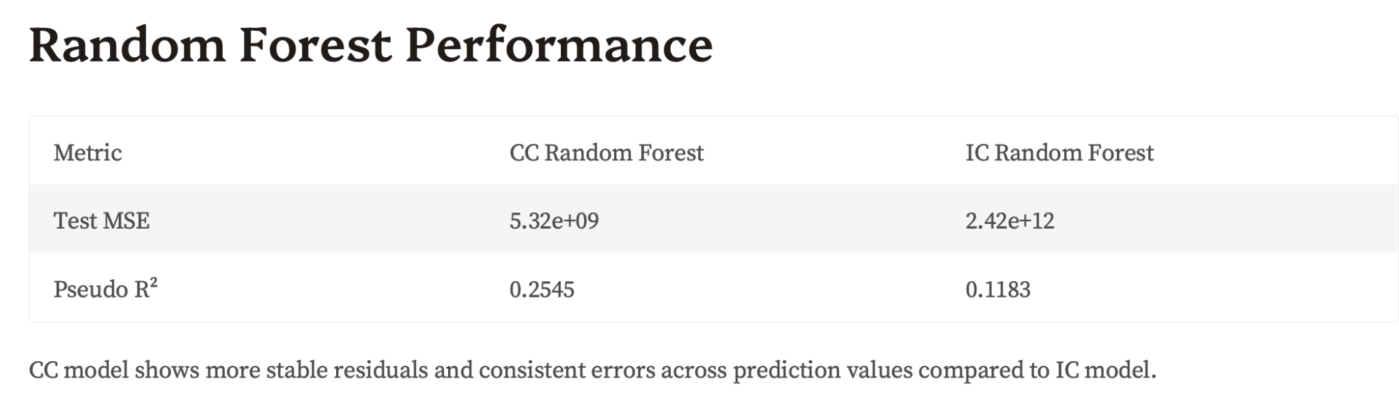
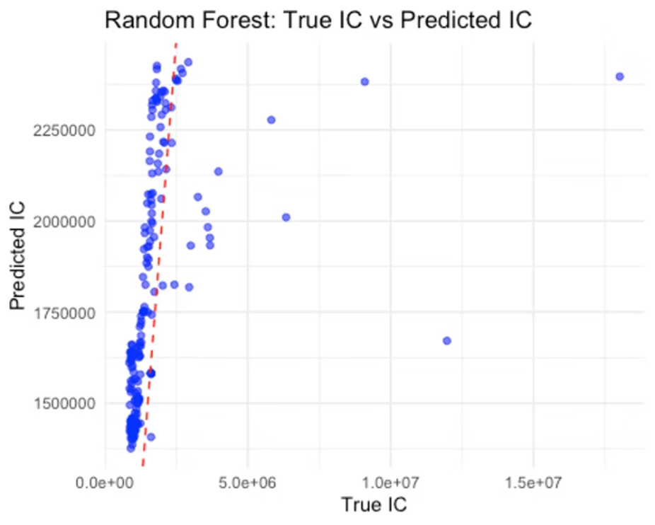
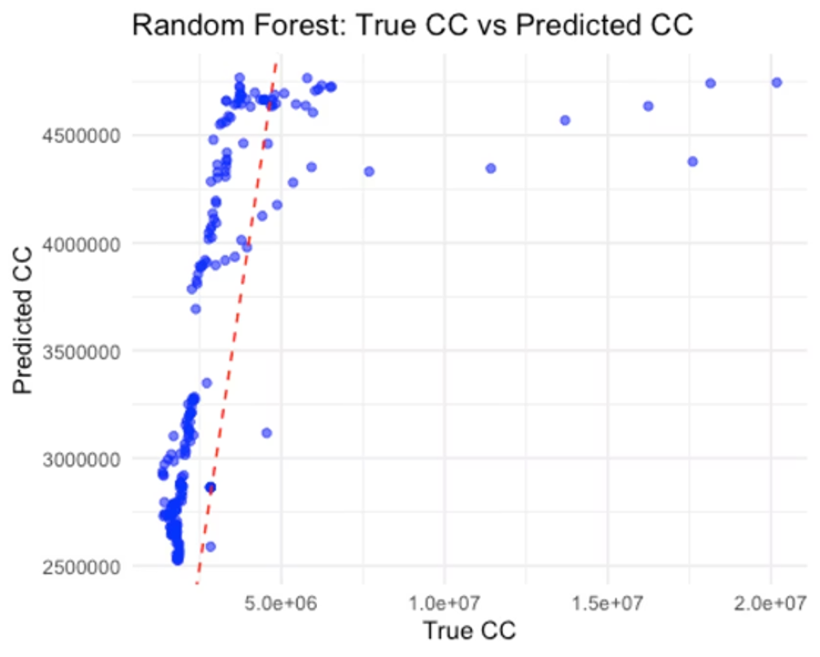

Slide 27
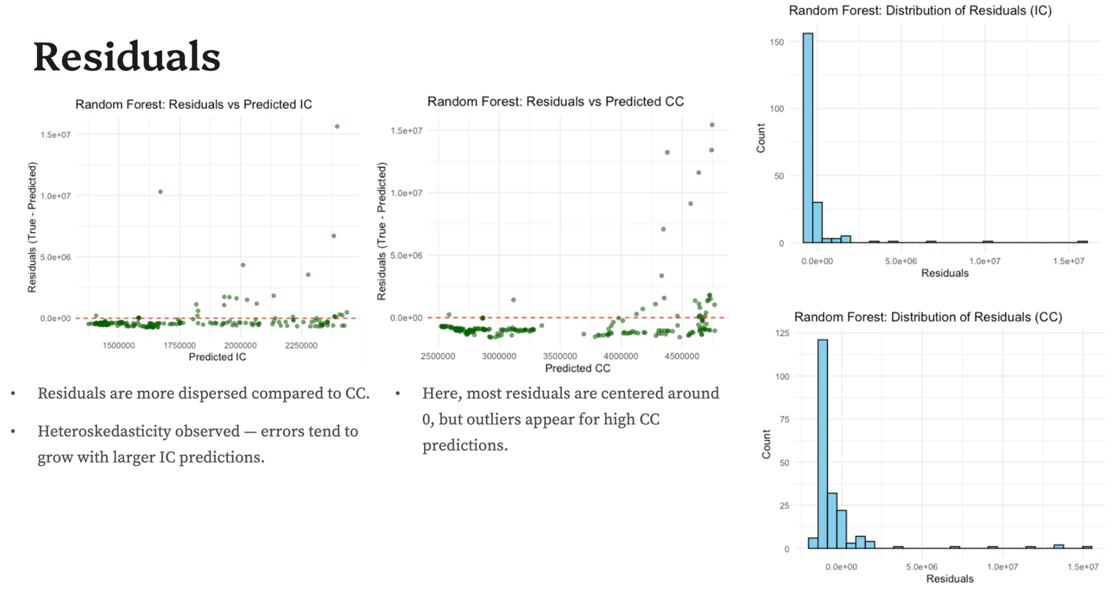

Slide 28
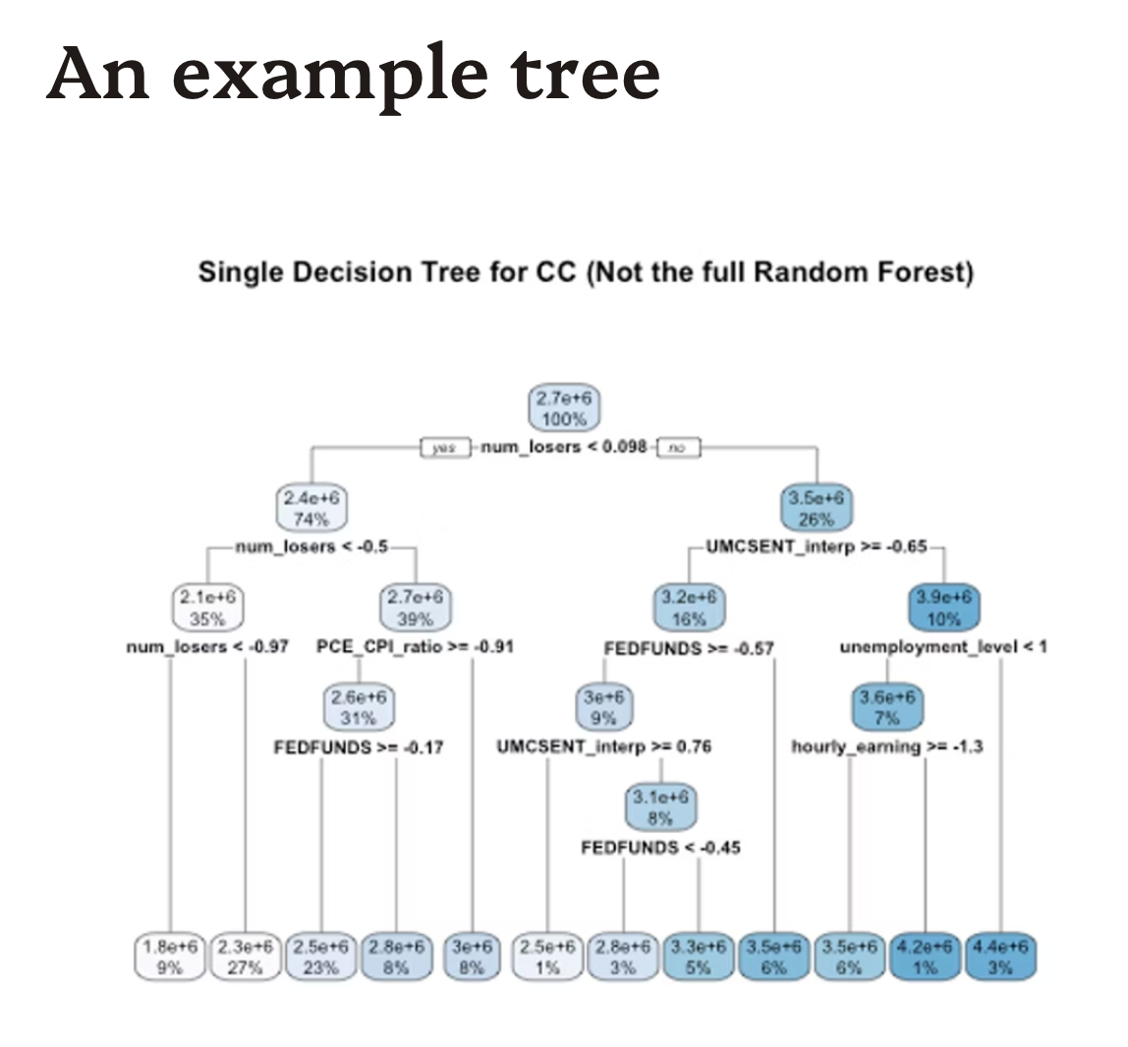

Slide 29
Comparison of Model MSEs
Model | CV MSE (IC) | CV MSE (CC)
OLS Regression | 1.032758e+12 | 1.882496e+12
PCA | 1.178781e+12 | 2.193817e+12
Lasso and Ridge | 4.965321e+11 | 8.405297e+11
Boosting | 6.127561e+11 | 3.135783e+11
GLM (gamma-log link) | 4639 | 73.7
Time series | N/A | N/A
KNN | 2.35e+12 | 5.30e+09
Random Forest | 5.32e+09 | 2.42e+12

Slide 30

Key Findings and Insights
Data Fusion Critical
Combining multiple indicators improved model robustness
Nonlinear Models Superior
Gamma GLMs and time-series models captured variance better
Random Forest produces lowest MSE for IC and KNN produces lowest MSE for CC

Slide 31

Next Steps and Recommendations
Expand Data Sources
Enhance Regime Models
Include real-time labor market and financial feeds
Incorporate more granular policy and regional variables
Implement Forecast Deployment
Build dashboards for continuous monitoring and decision support

Slide 32
Future work
Non-normality
Handling Outliers
Simple normalization method is ineffective, try Box-Cox transformation
Not removed for comparability purposes; can be removed to improve parts of the model.

